Slide 1
FIWARE Data Spaces
Deploying a FIWARE Dataspace Connector
Francisco de la Vega

Slide 2
Deploying a FIWARE DSC
Preconditions
Setting up the Trust Anchor
Deploying a Consumer
Deploying a Provider
Verifying the System

Slide 3
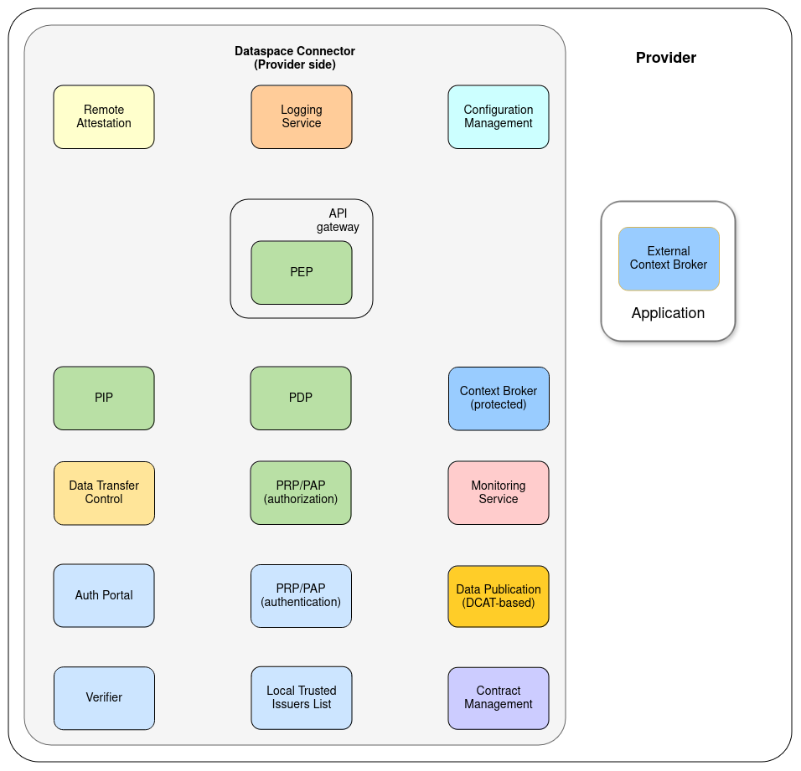
Preconditions
Microservice architecture
individual components can be enabled/disabled depending on the use-case
reuse of existing OpenSource-Components
various target environments
requires solutions for internal and external networking
support for configurable deployments
allows integration of existing OpenSource deployment recipes
abstraction of infrastructure

Slide 4


Preconditions
Kubernetes
  abstraction of infrastructure to a standardized API
  supports internal networking through SDN
  various options for external access, easy to control and configure
  OpenSource and well-maintained(CNCF graduated)
  various managed and self-hosted options available
Helm
  flexible configuration and configuration management
  uses well-established tools(mustache) and principles(sane defaults, only overwrite required parts)
  OpenSource and well-maintained(CNCF graduated)

Slide 5
Kubernetes
Kubernetes is an OpenSource container orchestration platform that automates deployment, scaling and management of containerized applications. It support different environments, such as on-premise data centers, public clouds or hybrid-setups.
service discovery and load balancing allows to connect the individual microservices, balance their traffic and scale them individually, depending on the load
provides self-healing and restart capabilities, to increase resilience of the system
abstraction of infrastructure(computation, storage, networking) allows reuse of same recipes through different environments
well-established and widely used

Slide 6
Helm
Helm is a package manager for Kubernetes that simplifies deployment and configuration of applications and services. It uses pre-configured templates of Kubernetes resources, enabling users to define, install and upgrade their applications
Kubernetes resources are provided as mustache-templates
contains defaults, allowing to install a standard-version with minimal additional configuration
natively supports versioning of deployment-recipes
allows reuse of existing “Charts” as dependencies
supports repackaging to umbrella-charts

Slide 7



Operational considerations
Monitoring
  Prometheus endpoints available for most components
  resource monitoring through Kubernetes
  should be integrated with existing monitoring
Logging
  levels can be configured individually for each component
  supports structured JSON-logging
  should be integrated with existing logging
Alerting
  based on monitoring and logging, should be integrated with existing systems
  additional tooling like Service Mesh should be based on concrete requirements

Slide 8
The Connector
Provided as Umbrella Helm-Chart: Data Space Connector Chart
  reuse of Charts from FIWARE Helm Charts and Bitnami Helm Charts
  extended with some convenience functionality for the Data Space Connector
  all Sub-Charts can be individually disabled
  individual parts can be exchanged(for example Databases, ApiGateway)
automatically tested on K3s
tested on Vanilla Kubernetes, contains support for OpenShift
minimal Trust-Anchor Chart contained in the repo, to allow setup of a full Data Space

Slide 9
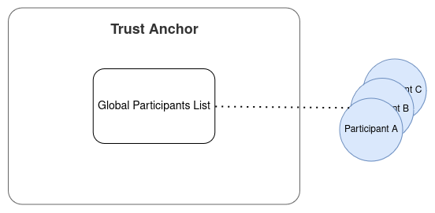
The Trust Anchor
Provide the Global Trusted Participants list through the EBSI Trusted Issuers Registry API
provide functionality to register new participants

Slide 10
The Trust Anchor
FIWARE Trusted Issuers List to provide two APIS: EBSI TIR API and TIL API for registration
MySql as storage backend for the participants
  DBaaS can be used

Slide 11
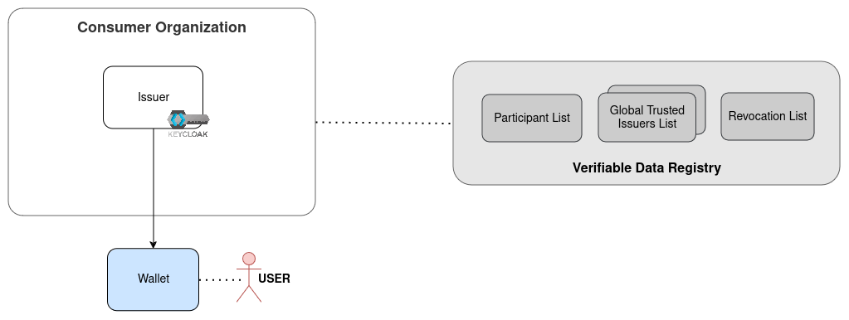
The Consumer
Issues credentials to its users and services
is registered at the Verifiable Data Registry

Slide 12
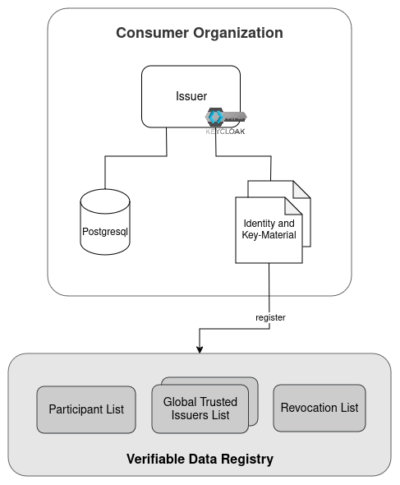
The Consumer
Keycloak(26) as the issuing component
  realm to be configured for OID4VCI
  users and roles configured
  credentials to be configured
Postgresql as Database for Keycloak
  DBaaS could be used
  Identity and Key-Material for the Organization have to be created and provided
  Organization has to be registered at the Verifiable Data Registry

Slide 13
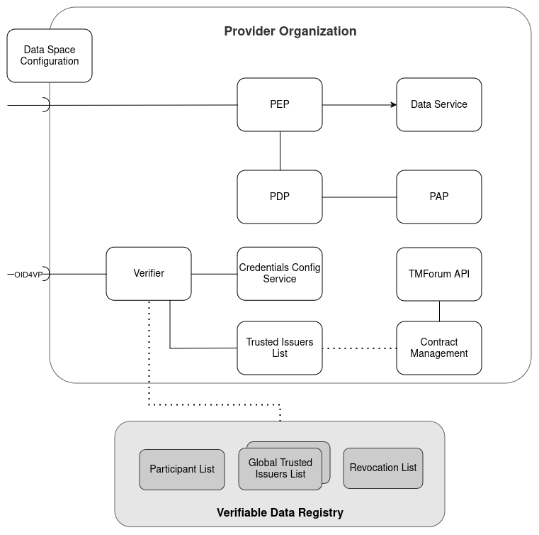
The Provider
Authentication Services:
  Verifier to offer OID4VP endpoints
  Trusted Issuers List and Credentials Config Service for authentication config
  registered and connected to Verifiable Data Registry
Authorization Services:
  PEP, PDP, PAP for enforcing and managing policies
  Data Service to be offered
Data Space Config as well-known endpoint

Slide 14
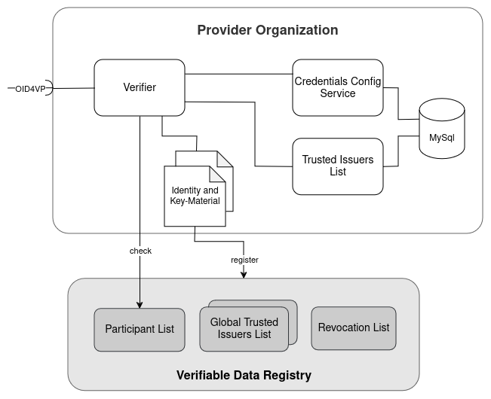
The Provider - Authentication
VCVerifier to offer OID4VP
Credentials Config Service and Trusted Issuers List to provide information about issuers and credentials for the verifier
MySql as Storage Backend(can be shared instance)
  DBaaS also possible
Identity and Key-Material for the Organization have to be created and registered

Slide 15
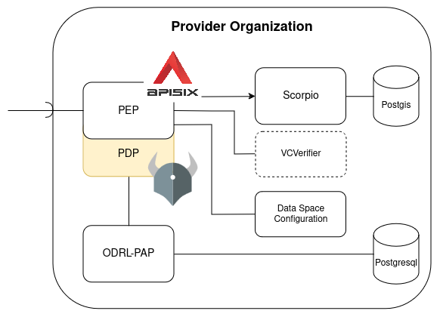
The Provider - Authorization
APISIX Gateway as PEP and central entrypoint
  routes .well-known/openid-configuration from Verfier
  routes .well-known/data-space-configuration from static fileserver
  checks JWT at Verifier
Open Policy Agent as PDP
  deployed as Sidecar for performance
ODRL-PAP for managing Policies
  Postgresql as storage backend, DBaaS also possible
Scorpio as NGSI-LD compliant Data Service
  Postgis as storage backend

Slide 16
Links
FIWARE Data Space Connector:
  https://github.com/FIWARE/data-space-connector
Demo-Deployment:
  https://github.com/fdelavega/deployment-demo

