Slide 1
Contract Negotiation and Marketplace
Francisco de la Vega
francisco.delavega@seamware.com

Slide 2
Agenda
TMForum Open APIs
Managing Users and Organizations
How to publish a product offering
How to acquire a product offering
Introduction to the FIWARE BAE Marketplace

Slide 3
TMForum Open APIs

Slide 4
TMForum Open APIs
Enable seamless connectivity, interoperability and portability across complex ecosystem services
TM Forum Open APIs are based on REST. They are technology agnostic and can be used in any digital service scenario
TM Forum Open APIs aim at:
  Enabling services to be managed end-to-end throughout their lifecycle
  Working in an environment where multiple partners are involved in service delivery
There are around 100 APIs covering different aspects of digital service management

Slide 5
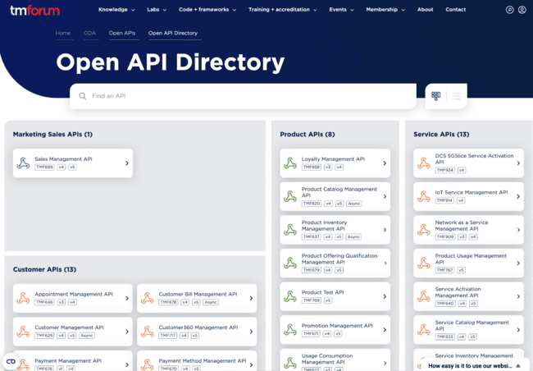
TMForum Open APIs
Specifications of the different APIs can be accessed from the TMForum Open API Directory
  https://www.tmforum.org/oda/open-apis/directory
A reference implementation of the core APIs is provided by FIWARE:
  https://github.com/FIWARE/tmforum-api

Slide 6
TMForum API Usage
TMForum models are served in JSON-LD format
All models in TMForum APIs share the following properties:
href: an URL that can be used to get the attributes of the entity
id: the id of the entity, defined as last part of the href path
@type: id identifying the type of the entity
@baseType: if of the type which the type identified with @type extends (equals @type if @type is a root type, i.e., does not extend any other type)
@schemaLocation: URL of the schema associated to the type
version: version of the concrete entity (since it may evolve over time)
lastUpdated: date and time of the last update of the entity
validFor: the time period during which the given entity is valid

Slide 7
TMForum API Usage
TMForum APIs are REST APIs (POST, GET, PATCH, DELETE)
TMForum APIs implement a simple query language:
Filter the results of the list operation using any of the attributes of the entity
  GET /individual?givenName=Francisco
  GET /catalog?relatedParty.id=12345
Providing different query params works as a AND
Providing multiple values works as an OR
The result can be filtered using the fields query param
  GET /catalog?relatedParty.id=12345&fields=name,description

Slide 8
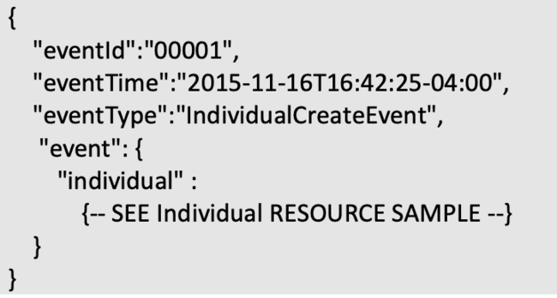
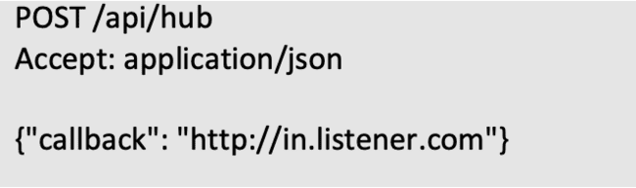
TMForum API Usage
TMForum APIs allow to subscribe to events
CreateEvent
AttributeValueChangeEvent
StateChangeEvent
DeleteEvent
Listeners are registered providing the URL where the notification needs to be sent
Notifications are sent including the event and the updated entity

Slide 9
TMForum API Usage
The TMForum APIs define two approaches for providing extra information on top of the attributes defined by default
  Characteristic-based: Most of the TMForum entities define a characteristic attribute that allows to provide a name and a value, so any required information can be provided
  JSON-LD based: the @baseType and @schemaLocation can be used to extend the JSON-LD model
The TMForum APIs allow their models to be extended using JSON-LD. This extension mechanism can be used both, in the entity and the attributes
To extend a model:
  Set the @baseType to the original @type of the model
  Set the @type to the new child class
  Add a proper @schemaLocation pointing to a valid JSON schema defining the new fields

Slide 10
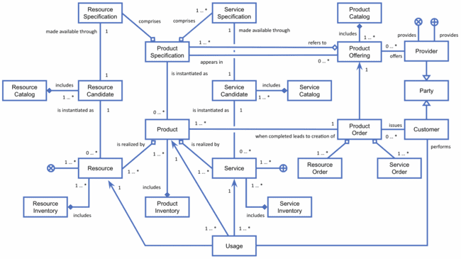
TMForum Entity Model

Slide 11
Managing Users and Organizations

Slide 12
Parties (Individuals and Organizations)
The TMForum Party Management API defines the individual as a single human being (a man, woman or child). The individual can be a customer, an employee or any other person that the organization needs to store information about
An individual entity includes info like:
  givenName: First name of the individual
  familyName: Contains the non-chosen or inherited name. Also known as last name in the Western context
  contactMedium: List of contact mediums. Indicates the contact medium that could be used to contact the party
  externalReference: A list of external references. External reference of the individual or reference in other system
  partyCharacteristic: A list of characteristics. Describes a given characteristic of an object or entity through a name/value pair

Slide 13
Parties (Individuals and Organizations)
The TMForum Party Management API defines the organization as a group of people identified by shared interests or purpose. Examples include business, department and enterprise. Because of the complex nature of many businesses, both organizations and organization units are represented by the same data
An organization entity includes info like:
  tradingName: Name that the organization (unit) trades under
  isLegalEntity: If value is true, the organization is a legal entity known by a national referential
  organizationType: Type of Organization (company, department...)
  contactMedium: A list of contact mediums. Indicates the contact medium that could be used to contact the party
  partyCharacteristic: List of characteristics. Describes a given characteristic of an object or entity through a name/value pair

Slide 14
Parties (Individuals and Organizations)
The TMForum Party Management API defines the organization as a group of people identified by shared interests or purpose. Examples include business, department and enterprise. Because of the complex nature of many businesses, both organizations and organization units are represented by the same data
An organization entity includes info like:
  tradingName: Name that the organization (unit) trades under
  isLegalEntity: If value is true, the organization is a legal entity known by a national referential
  organizationType: Type of Organization (company, department...)
  contactMedium: A list of contact mediums. Indicates the contact medium that could be used to contact the party
  partyCharacteristic: List of characteristics. Describes a given characteristic of an object or entity through a name/value pair

Slide 15
Accounts (Billing Account)
The TMForum Account Management API defines the Billing Account as a party account used for billing purposes. It includes a description of the bill structure.
A billing account entity includes info like:
  name: Name of the account
  accountType: A categorization of an account, such as individual, joint, and so forth, whose instances share some of the same characteristics
  contact: An individual or an organization used as a contact point for a given account and accessed via some contact medium

Slide 16
How to publish a product offering

Slide 17
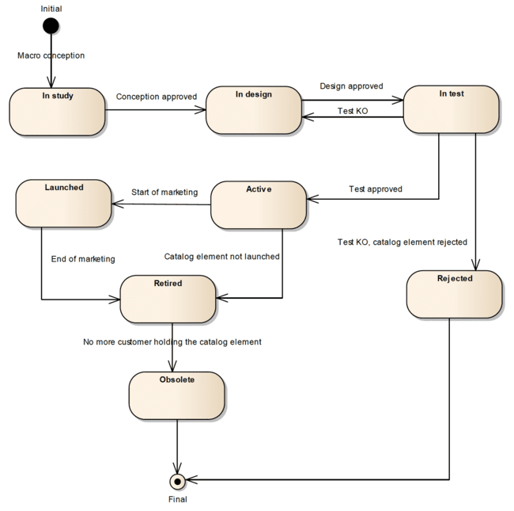
Catalog Lifecycle
The TMForum Catalog Management API defines a lifecycle for catalog elements:
  Active: The element is not ready for monetization
  Launched: The element is available for being discovered and acquired
  Retired: The element is no longer available for acquiring by customers keep it
  Obsolete: The element cannot be acquired nor accessed by customers

Slide 18
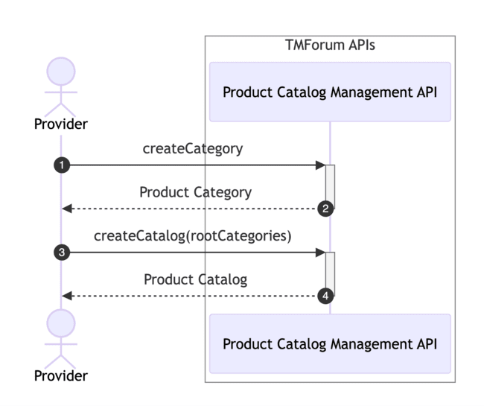
Create Catalogs and Categories
Product Categories
  The product category resource is used to group product offerings. Product Categories can contain other categories and/or product offerings
A product category includes:
  name: Name given to the category
  description: A narrative that explains in detail the category.
  version: Category version
  isRoot: Whether the category is a root category or not
  parentId: Id of the parent category of the category is not root

Slide 19
Create Catalogs and Categories
Product Catalog
  A collection of Product Offerings intended for a specific Distribution Channel and Market Segment
  The product catalog includes a list of root categories indicating which of them belong to it
A product catalog includes:
  name: Name given to the catalog
  description: A narrative that explains in detail the catalog
  category: List of category references (Points to category objects as defined in this API)
  relatedParty: List of parties related to the catalog including the ID and role played

Slide 20
Register Specifications
Service Specification
  Offers a set characteristics to describe a type of service. Functionally, it acts as a template by which Services may be instantiated. By sharing the same specification, these services would therefore share the same set of characteristics
A service specification includes:
  name: Name given to the specification
  description: Description of the specification
  relatedParty: Parties who manage or otherwise have an interest in this specification including the ID and role
  specCharacteristic: List of characteristics that the entity can take

Slide 21
Register Specifications
Resource Specification
  Physical or non-physical components within an enterprise's infrastructure or inventory. They are typically consumed or used by services or contribute to the realization of a Product. They can be drawn from the Application, Computing and Network domains, and include, for example, Network Elements, software, IT systems,content and information, and technology components
A resource specification includes:
  name: Name given to the specification
  description: Description of the specification
  relatedParty: Parties who manage or otherwise have an interest in this specification including the ID and role
  resourceSpecCharacteristic: List of characteristics that the entity can take

Slide 22
Register Specifications
Product Specification
  Detailed description of some of the attributes that will characterize Products created when a Product Offering is successfully ordered (procured)
  It links to the list of service specifications and resource specifications that define the digital service being offered
A product specification includes:
  name: Name of the product specification
  description: A narrative that explains in detail what the product specification is
  productSpecCharacteristic: A list of product specification characteristics A characteristic quality or distinctive feature of a ProductSpecification. Product specification characteristics have a direct impact on the final pricing charged to the customers allowing option selection and configuration
  resourceSpecification: A list of Resource Specification references, where each Resource Specification is needed to realize the product specification
  serviceSpecification: A list of Service Specification references, where each Service Specification is needed to realize the product specification

Slide 23
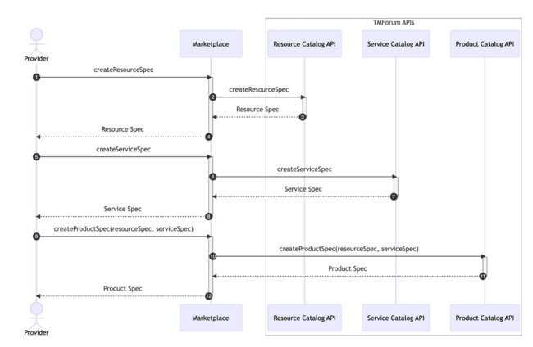
Register Specifications

Slide 24
Create price plans
Product Offering Price
  Refers to a pricing model associated with a Product Offering. There may be multiple Product Offering Prices associated with a Product Offering
A combination of Product Offering Prices is used to create different price plans for a product offering as follows:
  Each price plan is defined as a Product Offering Price entity with isBundle value set to true
  A price plan may define a particular Product Offering Term duration
  Each price component is defined as a Product Offering Price entity linked to the bundle, defining a simple pricing (one time, recurring, usage)
  Discounts and fees can be added to the plan by linking a Product Offering Price entity defining an alteration
  Some price components may be applied only when a particular product characteristic value have been selected
  A Product Offering Price may define a unit price, whose final value depends on the product characteristic value selected

Slide 25
Create price plans
If a product offering price is defining a plan, it includes:
name: Name of the price plan
description: description of the price plan
isBundle: Whether this entity is a bundle. This value is set to true
bundledPopRelationship: List of product offering prices used as price components
prodSpecCharValueUse: List of values for the offered Product Specification Characteristics, that must be selected to be able to apply this plan. This attribute works as a configuration profile when provided at plan level
If a product offering price is defining a price component, it includes:
name: Name of the price plan
description: description of the price plan
isBundle: Whether this entity is a bundle. This value is set to false
priceType: A category that describes the price, such as recurring, one time or usage
price: The amount of money that characterizes the price
prodSpecCharValueUse: List of values for the offered Product Specification Characteristics, that must be selected to be able to apply this component. This attribute works as a filter when provided as component level

Slide 26
Publish product offerings
Product Offering
  Represents offerings on products that are orderable from the provider of the catalog. It includes specification of the products, pricing information and other characteristics of the Product that gets created when a Product Offering is procured
It includes
  name: Name of the product offering
  description: A narrative that explains in detail what the product offering is
  category: List of Category references pointing to categories that apply to the product offering
  productSpecification: Product Specification being offered
  productOfferingPrice: List of price plans defined before that can be selected by the customers

Slide 27
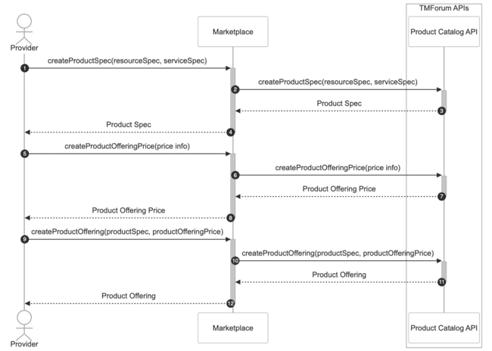
Publish product offerings

Slide 28
How to acquire a product offering

Slide 29
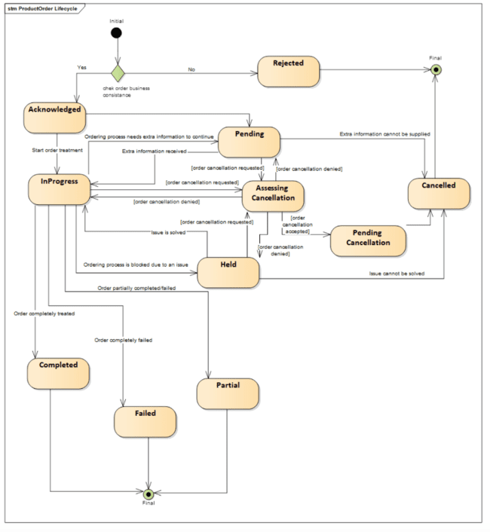
Product Order Lifecycle
The Product Ordering Management API defines the following lifecycle:
Acknowledged: The order has been accepted by the provider
Rejected: The order has been rejected by the marketplace
InProgress: The order is being processed
Completed: The order has been fully processed
Failed: All the order items have failed during the processing of the order
Partial: Some of the items have been processed and some have failed

Slide 30
Create product order
Product Order
  A Product Order is a type of order which can be used to place an order between a Party (customer or other interested party) and a service provider. It is connected to a Product Offering in the Product Catalog and, when successfully completed, leads to creation of a Product in the Product Inventory
A product order item includes:
  productOffering: Link to the product offering that is being acquired
  itemTotalPrice: Link to the product offering price that defines the selected price plan
  product.productCharacteristic: List of characteristics values that have been selected by the customer
  billingAccount: Link to the customer billing account
  relatedParty: Link to the parties involved including customer and seller

Slide 31
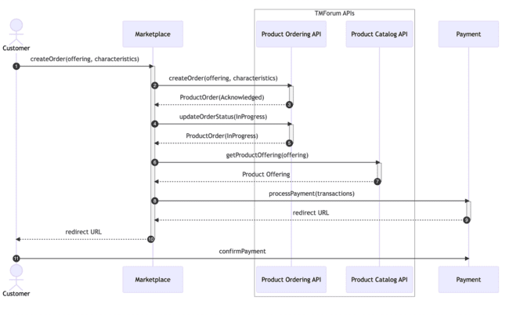
Create product order

Slide 32
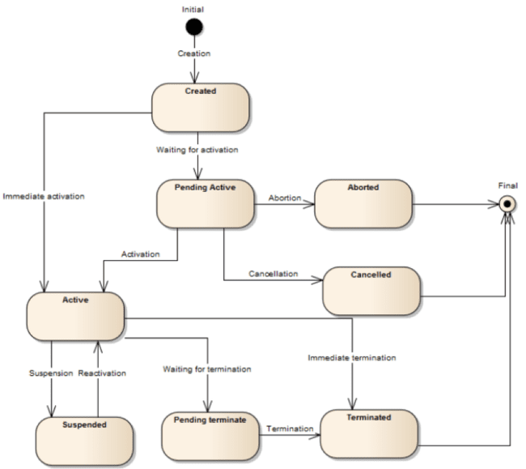
Inventory Product Lifecycle
The Product Inventory Management API defines the following lifecycle:
Created: The product has been registered in the inventory, but it needs to be activated for the customer
Active: The product has been activated by the customer
Suspended: The access to the product has been suspended (i.e the customer has not paid)
Terminated: The access to the product has been fully terminated

Slide 33
Inventory instances
Product
  A product offering procured by a customer or other interested party playing a party role. A product is realized as one or more service(s) and / or resource(s)
Service
  Represents the real services procured during the activation phase
Resource
  Represents the real resources procured during the activation phase

Slide 34
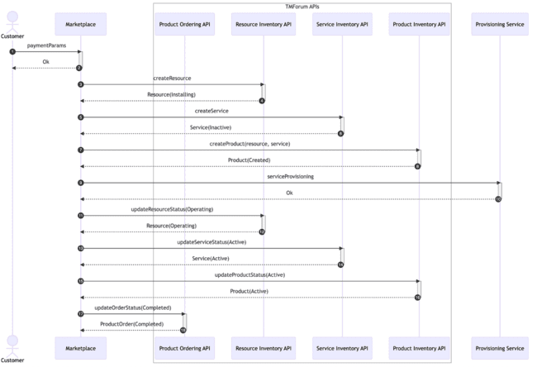
Inventory instances

Slide 35
Introduction to the FIWARE BAE Marketplace

Slide 36
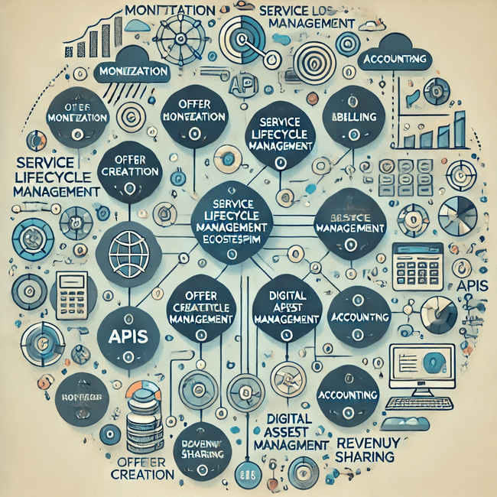
Business API Ecosystem GE
Component of the FIWARE platform
Supports the creation of digital marketplaces for the monetisation of digital services
Manages the lifecycle of products offers, from product creation to monetisation, billing and payment
Relies on TM Forum Business Ecosystem Open APIs

Slide 37

Business API Ecosystem GE
BAE has been designed to be customized for the specific use case
  Branding and theming support
  Multiple identity providers supported, including FIWARE Keyrock, Keycloak, GitHub and VC using the FIWARE verifier
New IDPs and protocols can be integrated in the software
Different payment gateways can be integrated

Slide 38
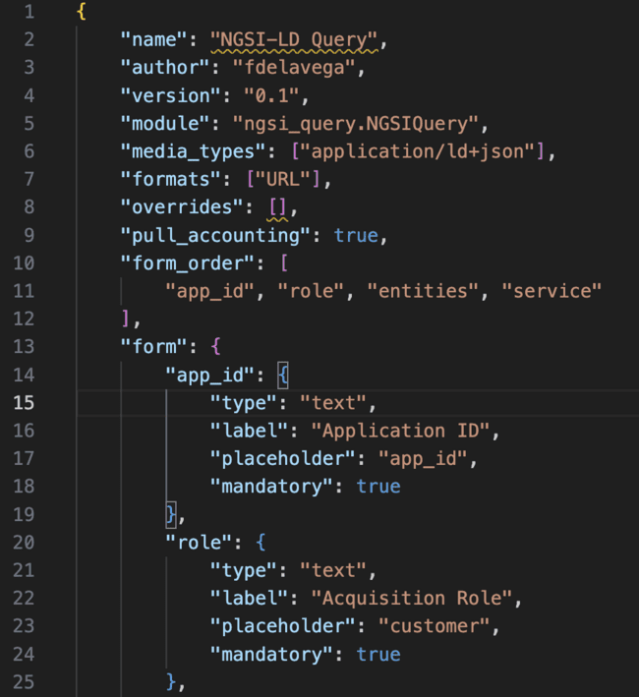
Business API Ecosystem GE
Support for different kind of digital service monetization via plugins
  Define the asset type
  Define the metadata to be retrieved and stored
  Implements handlers to validate and process asset data during the product lifecycle
  Performs service activation during acquisition
Plugin are managed as zip files, including:
  JSON file with plugin configuration
  Python class with handler implementation
  Any needed python code

Slide 39
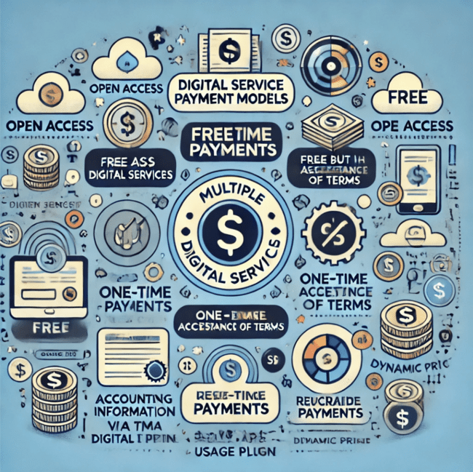
Business API Ecosystem GE
Supports multiple price plans, including free plans:
Open: Published digital services can be accessed or downloaded without buying
Free: Require offer to be acquired and terms of service accepted
and paid plans, as combinations of:
One time: Single payment for the service
Recurring: Weekly, monthly, etc
Usage: Actual payment calculated based on usage.
Require accounting information that can be submitted via TMForum Usage API or retrieved by the digital asset plugin
Advanced models
Fees, discounts, dynamic pricing

Slide 40
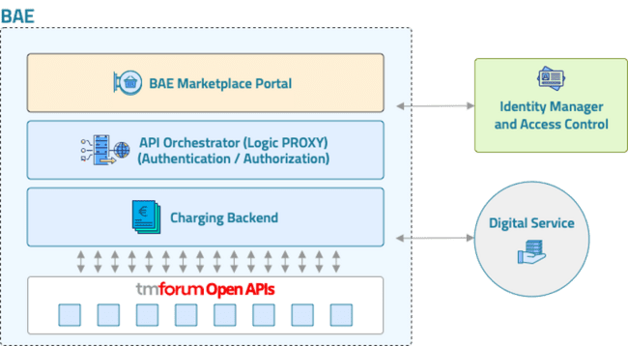
Architecture of the BAE
The Business API Ecosystem software is made up of a couple or orchestrated microservices
BAE Portal: Web GUI used to interact with the system
Business Ecosystem Logic Proxy: This component provides the entry point to the system
  Gives API Access
  Integrates with the IDP
  Validates the user permissions
  Orchestrates the APIs
Business Ecosystem Charging backend: This component provides billing and charging processing
  Manages digital services
  Calculates and executes payments
  Activates and deactivates services

Slide 41
Architecture of the BAE
The Business API Ecosystem uses the core set of TM Forum Open APIs for digital service monetisation features
Product Lifecycle
  Product, Service, and Resource Catalog Management API
  Product Ordering Management API
  Product, Service and Resource Inventory Management API
User and customer management
  Party Management API
  Account Management API
  Billing Management API
Usage Management API

Slide 42
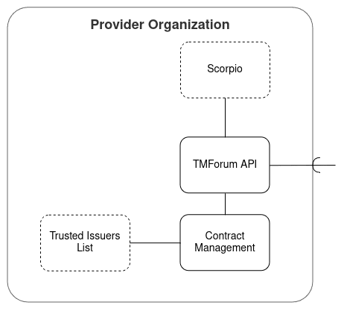
FDC Integration
TMForum API's to offer marketplace and contracting functionality
  uses an NGSI-LD Context Broker as storage backend
Contract Management to integrate TMForum with the Authentication of the Data Space connector

Slide 43
Links
Local deployment repo:
https://github.com/FIWARE/data-space-connector/blob/fix-local-deploy/doc/deployment-integration/local-deployment/LOCAL.MD

Slide 44
Thanks!

